Slide 1

Strategies
The decisions and actions that determine the long-run performance of an organization.
Strategic Management Process
8–<number>

Slide 2
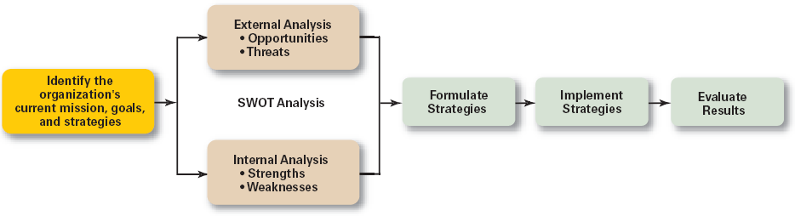
Exhibit 8–1 The Strategic Management Process
© 2007 Prentice Hall, Inc. All rights reserved.
8–<number>

Slide 3
Step 1: Identifying the organization’s current mission, goals, and strategies
  Mission: the firm’s reason for being
  Goals: Measurable
Step 2: Doing an external analysis
  Specific and general environments
  PEST AND Porter
© 2007 Prentice Hall, Inc. All rights reserved.
8–<number>

Slide 4
Step 3: Doing an internal analysis
  Assessing organizational
    resources, capabilities, and activities
    Financial and physical assets
    intangible assets (employee’s skills, culture, corporate reputation
Steps 2 and 3 combined are called a SWOT analysis. (Strengths, Weaknesses, Opportunities, and Threats)
© 2007 Prentice Hall, Inc. All rights reserved.
8–<number>

Slide 5
Step 4: Formulating strategies
Step 5: Implementing strategies
Step 6: Evaluating results
© 2007 Prentice Hall, Inc. All rights reserved.
8–<number>

Slide 6

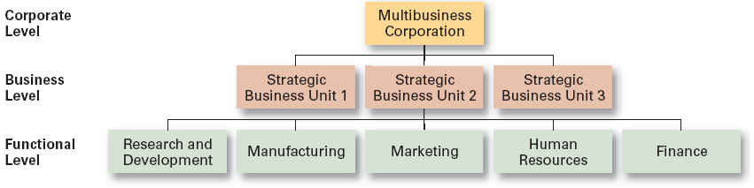
© 2007 Prentice Hall, Inc. All rights reserved.
8–<number>

Slide 7
1) Corporate Strategies
  Top management’s overall plan for the entire organization and its strategic business units
Types of Corporate Strategies
  Growth: expansion into new products and markets
  Stability: maintenance of the status quo
  Renewal: redirection
© 2007 Prentice Hall, Inc. All rights reserved.
8–<number>

Slide 8
Corporate Strategies
1) Growth Strategy
Types of Growth Strategies
  Concentration
  Vertical integration
  Horizontal integration
  Diversification
© 2007 Prentice Hall, Inc. All rights reserved.
8–<number>

Slide 9
1) Concentration
  Focusing on a primary line of business and increasing the number of products offered or markets served.
2) Vertical Integration
  Backward vertical integration: attempting to gain control of inputs (become a self-supplier).
  Forward vertical integration: attempting to gain control of output through control of the distribution channel or provide customer service activities (eliminating intermediaries).
© 2007 Prentice Hall, Inc. All rights reserved.
8–<number>

Slide 10
3) Horizontal Integration
  Combining operations with another competitor in the same industry to increase competitive strengths and lower competition among industry rivals.
4) Related Diversification
  Expanding by combining with firms in different, but related industries that are “strategic fits.”
Unrelated Diversification
  Growing in unrelated industries where higher financial returns are possible.
© 2007 Prentice Hall, Inc. All rights reserved.
8–<number>

Slide 11

  A strategy that seeks to maintain the status quo to deal with the uncertainty of a dynamic environment, when the industry is experiencing slow- or no-growth conditions, or if the owners of the firm elect not to grow for personal reasons.
© 2007 Prentice Hall, Inc. All rights reserved.
8–<number>

Slide 12

  Developing strategies to counter organization weaknesses that are leading to performance declines.
    Retrenchment: focusing of eliminating non-critical weaknesses and restoring strengths to overcome current performance problems.
    Turnaround: addressing critical long-term performance problems through the use of strong cost elimination measures and large-scale organizational restructuring solutions.
© 2007 Prentice Hall, Inc. All rights reserved.
8–<number>

Slide 13

© 2007 Prentice Hall, Inc. All rights reserved.
8–<number>

Slide 14

© 2007 Prentice Hall, Inc. All rights reserved.
8–<number>

Slide 15
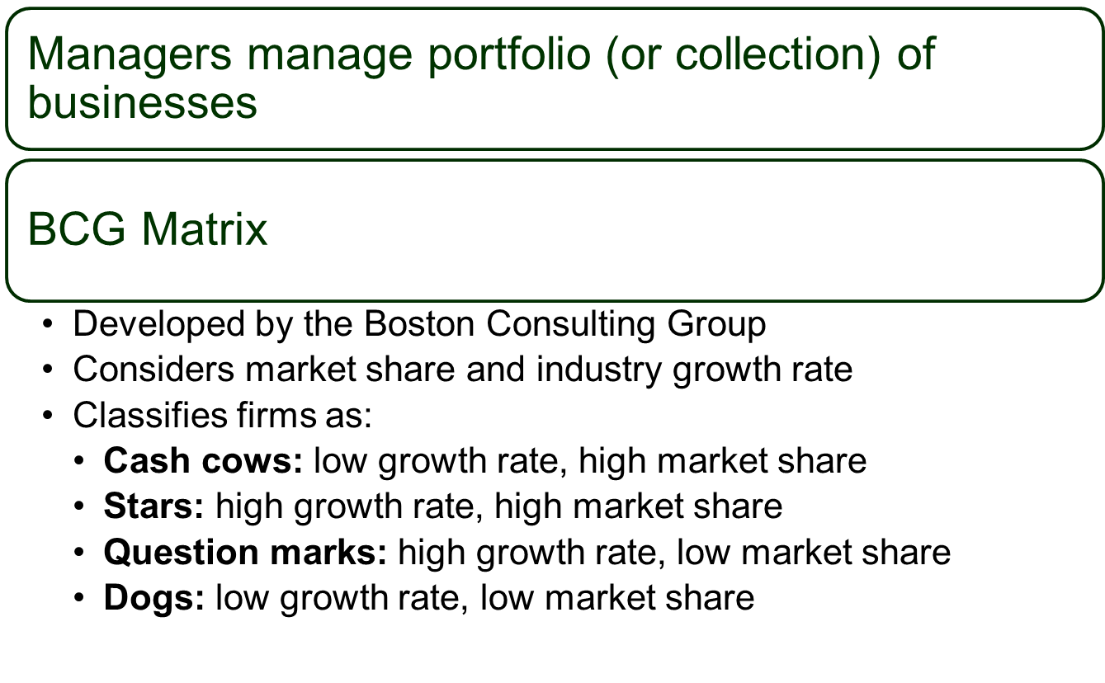
© 2007 Prentice Hall, Inc. All rights reserved.
8–<number>

Slide 16
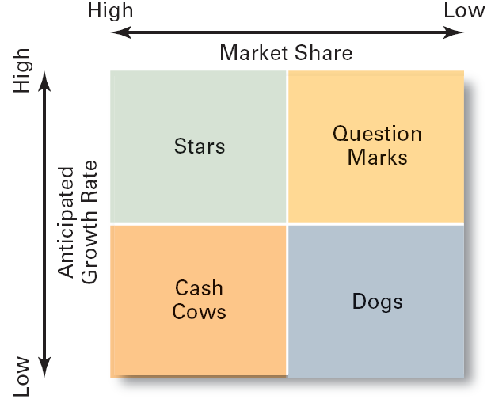
Exhibit 8–5 The BCG Matrix
© 2007 Prentice Hall, Inc. All rights reserved.
8–<number>

Slide 17

  A strategy focused on how an organization should compete in each of its SBUs (strategic business units).
© 2007 Prentice Hall, Inc. All rights reserved.
8–<number>

Slide 18

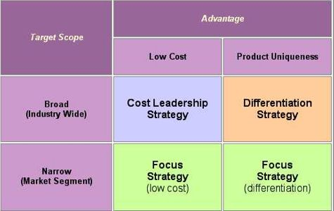
Cost Leadership Strategy
Differentiation Strategy
Focus Strategy
8–<number>

Slide 19
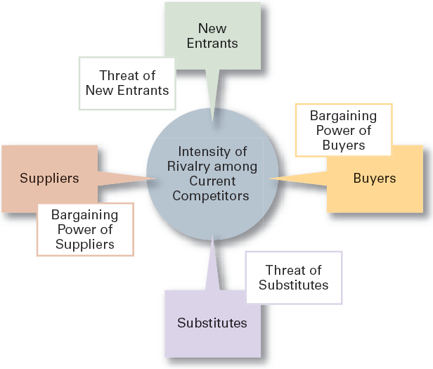
8–<number>

